Slide 1
Anne Pépin
Senior Policy Officer, Gender Sector
D4 – Democracy & European Values
DG Research & Innovation
WEBINAR ΟΝ CROSS-CUTTING ISSUES IN HORIZON EUROPE - CYPRUS
28 May 2021

Slide 2
Policy and legal context
Horizon Europe

Slide 3
von der Leyen priority: Fostering a “Union of Equality”
Gender-balanced College of Commissioners
Target of 50% women managers at all levels by 2024
Commissioner for Equality (Helena Dalli) + Task Force for Equality: equality mainstream
Communication on ‘A Union of Equality: Gender Equality Strategy 2020-2025’ (05/03/2020)
  R&I and Horizon Europe are explicitly addressed, with new measures announced, including:
    The possibility to require a gender equality plan from applicants
    Initiatives to increase the number of women-led technology start-ups (EIC)
    Funding for gender and intersectional research will also be made available
5 more strategies adopted:
  EU Anti-racism Action Plan 2020-2025 (18/09/2020)
  EU Roma strategic framework for equality, inclusion and participation (07/10/2020)
  LGBTIQ Equality Strategy 2020-2025 (12/11/2020)
  Gender Action Plan III – a priority of EU external action (25/11/2020)
  Strategy for the Rights of Persons with Disabilities 2021-2030 (03/03/2021)
Upcoming: Legislative initiative on gender based violence

Slide 4
Policy and funding context
Gender equality through institutional change: a priority of the European Research Area, and the Framework Programmes
Support to the implementation of Gender Equality Plans (GEPs) in research organisations, higher education establishments and public bodies for over a decade: through FP7 and Horizon 2020, over 200 organisations supported through 30 GEP-implementing projects, plus additional initiatives including guidance, trainings and communities of practice on GEPs

Slide 5







FP7-Science-in-Society Gender Projects
2007
2008
2009
2010
2011
2012
2013
Structural change in research organisations and universities
Survey Database of programmes
Debate
Guidelines
Implement Gender Action/Equality Plans
Initial focus on STEM
Methodology/Partner for impartially monitoring/assessing progress
Produce Guidelines
Gender management
Gender dimension in research content
PRAGES
WHIST
DIVERSITY
genSET
GENDERA
INTEGER
GENIS LAB
FESTA
STAGES
GENOVATE
GENDERTIME
TRIGGER
GARCIA
EGERA
9 GEP projects
European Commission : CORDIS : Search : Results page (europa.eu)

Slide 6














Building on Horizon 2020-SwafS Gender Projects
2014
2015
2016
2017
2018
2019
2020
RPOs and RFOs - Partners at a starting stage - Professional associations – Link with national level
Support from the highest management level
Explain role of middle management
Make use of the GEAR Tool (2016)
GENERA
LIBRA
PLOTINA
SAGE
EQUAL-IST
Baltic Gender
TARGET
GEECCO
CHANGE
SUPERA
R-I PEERS
Gender-SMART
GEARING-ROLES
SPEAR
CALIPER
LeTSGEPs
EQUAL4EUROPE
TARGETED-MPI
RESET
ATHENA
MINDtheGEPs
21 GEP projects
The GEAR tool with step-by-step guidance on setting up and implementing GEPs is currently being updated
EC
GEP Cluster event (28 Feb 2018)
EC
GEP Workshop
(4 March 2020)

Slide 7
CY participation in Horizon 2020 – SwafS
Project | Participant
GENDERACTION | IDRYMA PROOTHISIS EREVNAS
TARGET (GEP) | IDRYMA PROOTHISIS EREVNAS
GENDER NET Plus | IDRYMA PROOTHISIS EREVNAS
R-I PEERS (GEP) | CYPRUS NEUROSCIENCE AND TECHNOLOGY INSTITUTE
Gender-SMART (GEP) | TECHNOLOGIKO PANEPISTIMIO KYPROU

Slide 8


She Figures 2021 - Preliminary Results
 | (EU-27)
PhD women graduates | 48.1 % | 49.2 %
PhD women graduates Engineering, manufacturing and construction | 29.4 % | 22.73 % (5/22)
Women Researchers | 32.8 % | 38.1 %
Women in grade A positions | 26.2 % | 13.3 %
Women Heads of institutions in HES | 23.6 % | 9.1 %
Women board leaders | 24.5 % | 0 % (2 in total)
Women board members | 31.1 % | 26.3 % (5/19)

Slide 9
ERA : Gender Equality to strengthen the European R&I potential
Persisting gender inequalities in European R&I systems hinder the ERA’s potential: under-representation of women in STEM, only 24% in top academic positions, under 10% among patent holders, gender-based violence, and low level of integration of sex/gender analysis in R&I content
Need to address inclusiveness: with intersecting social categories (e.g. ethnicity, sexual orientation, disability), private/innovation sector, geographical inclusiveness
The Commission will:
Propose as of 2021, in line with the Horizon Europe programme objectives, the development of inclusive gender equality plans with Member States and stakeholders in order to promote EU gender equality in R&I

Slide 10
Council Conclusions on the new ERA
Council Conclusions on the New European Research Area (adopted on 1 December 2020)
  CALLS on the Commission and Member States to agree on priority actions as part of an ERA policy agenda in 2021, including on actions in the following domains:
  ii. Gender Equality:
  RECALLS with great concern that there continues to be a major gender imbalance preventing Europe from using the full potential of its R&I system aiming for excellence,
  and CALLS on the Commission and Member States for a renewed focus on gender equality and mainstreaming, including through the instrument of gender equality plans and the integration of the gender dimension into R&I content.
  INVITES Member States and research funding organisations to advance measures to ensure that allocation of research funding is not affected by gender bias.

Slide 11
Gender Equality
Horizon Europe

Slide 12



Gender Equality Plan: Eligibility Criterion
Gender equality: a strengthened crosscutting priority in Horizon Europe
Article 7(6) and Recital 53 of Framework Regulation
Articles 2(2)(e) and 6(3)(e) of the Specific Programme
Integration of the gender dimension: Award Criteria
Gender balance: Ranking Criteria

Slide 13
Gender Equality Plans
Horizon Europe eligibility Criterion

Slide 14
Eligibility Criterion
  Gender Equality Plan (applicable from 2022 onwards)
Participants that are public bodies, research organisations or higher education institutions* established in a Member State or Associated Country must have a gender equality plan in place, fulfilling mandatory process-related requirements
  A self-declaration will be requested at proposal stage (for all categories of participants)
  Included in the entity validation process (based on self-declaration)
* Private-for-profit entities (incl. SMEs), NGOs, CSOs, as well any type of organisations from
non-associated third countries, are exempted for the criterion
See legal categories definitions in the Funding & Tenders Portal here

Slide 15



Mandatory GEP process requirements
Public document
Dedicated resources
Data collection and monitoring
Training and capacity building
Formal document
Signed by top management
Published on the institution’s website
Disseminated through institution
Funding for gender equality positions or teams
Reserved time for others to work on gender equality
Data on sex or gender of staff across roles and leadership
Annual reports and evaluation of progress and outcomes
Whole organisation engagement
Joint action on specific topics
Tackle gender biases of people and decisions

Slide 16

Recommended GEP content areas
Work-life balance and organisational culture
Gender balance in leadership and decision-making
Gender equality in recruitment and career progression
Integrating the gender dimension into research and teaching content
Measures against gender-based violence, including sexual harassment
Essential factors for gender equality in R&I
Co-design session:
Get ready: a new ERA for Equality is calling (22/09/2020)
Video Recording on YouTube

Slide 17
The eligibility criterion steps
Self-declaration by Horizon Europe applicants through GEP eligibility criterion questionnaire*
The GEP must be in place for the signature of the Grant Agreement (for calls with deadlines from 2022 onwards)
Equivalent strategic documents may meet the GEP eligibility criterion
Grant Agreement (Art.14) commits beneficiaries to taking measures to promote gender equality in implementation of action and, where applicable, in line with their GEP
Random eligibility compliance checks on beneficiaries during Horizon Europe

Slide 18
Supporting GEP practice
Extensive knowledge and support on GEPs already available
The GEAR tool (‘Gender Equality in Academia and Research’): a step-by-step online guidance co-developed by DG RTD and EIGE for implementing GEPs, including e.g.:
  Action toolbox: key themes to consider in a GEP
  Concrete examples of good practices, building on GEP projects funded under FP7 and Horizon 2020
  Who is involved in GEPs
  Legislative and policy backgrounds in each Member State
Additional guidance and support on GEPs upcoming, including through a Pilot knowledge and support facility on institutional change through GEPs
→ trainings, mutual learning workshops, national GEP contact points

Slide 19
Integration of the gender dimension in R&I content
Horizon Europe Award CRITERIA

Slide 20

Integration of the gender dimension in R&I content
Addressing the gender dimension in research and innovation entails taking into account sex and gender in the whole research & innovation process.
Gender
dimension
Under Horizon Europe the integration of the gender dimension into R&I content is mandatory unless the topic description explicitly includes a sentence such as the following:
“In this topic the integration of the gender dimension (sex and gender analysis) in research and innovation content is not a mandatory requirement.”
Why is the gender dimension important?
Every cell is sexed and every person is gendered
Brings added value of research in terms of excellence, rigor, reproducibility, creativity and business opportunities
Brings an in-depth understanding of all people’s needs, behaviours and attitudes
Goods and services better suited to the needs of all citizens
Enhanced societal relevance of research and innovation

Slide 21
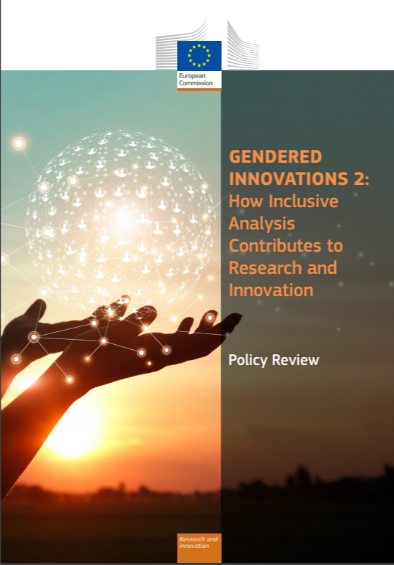
Gendered Innovations : How inclusive analysis contributes to research and innovation
15 new case studies in health, AI & robotics, climate change, energy, transport, urban planning, waste management, agriculture, taxation, venture funding) building on Horizon 2020 funded projects
Refined methodologies on the integration of sex/gender based analysis, and intersectional analysis, in R&I content
Evidence-based policy recommendations for Horizon Europe
Awareness raising material including factsheets
Case study on the impact of sex & gender in the COVID-19 pandemic
Factsheet on gender and intersectional bias in AI
Full Policy Review Report and Factsheet released on 25 November 2020
Interview of Commissioner Gabriel in KILDEN News (25/11/2020)
Nature editorial (09/12/2020)

Slide 22
Gender balance in research teams
Horizon Europe PROPOSAL RANKING CRITERIA

Slide 23
Ranking Criteria for ex aequo proposals
  Method to establish the priority order
  For each group of proposals with the same score, starting with the group achieving the highest score and continuing in descending order:
Aspects of the call that have not otherwise been covered by more highly ranked proposals
Scores on ‘Excellence’ then on ‘Impact’ (for IAs, scores on ‘Impact’ then ‘Excellence’)
Gender balance among personnel named in the proposal who will be primarily responsible for carrying out the research and/or innovation activities, and who are included in the researchers table in the proposal
Geographical diversity
Other factors set by the panel
  Three gender identity categories: woman, man, non-binary

Slide 24
Useful Resources
Horizon Europe

Slide 25
Factsheet on key Gender Equality provisions under Horizon Europe
https://op.europa.eu/en/web/eu-law-and-publications/publication-detail/-/publication/c0b30b4b-6ce2-11eb-aeb5-01aa75ed71a1

Slide 26
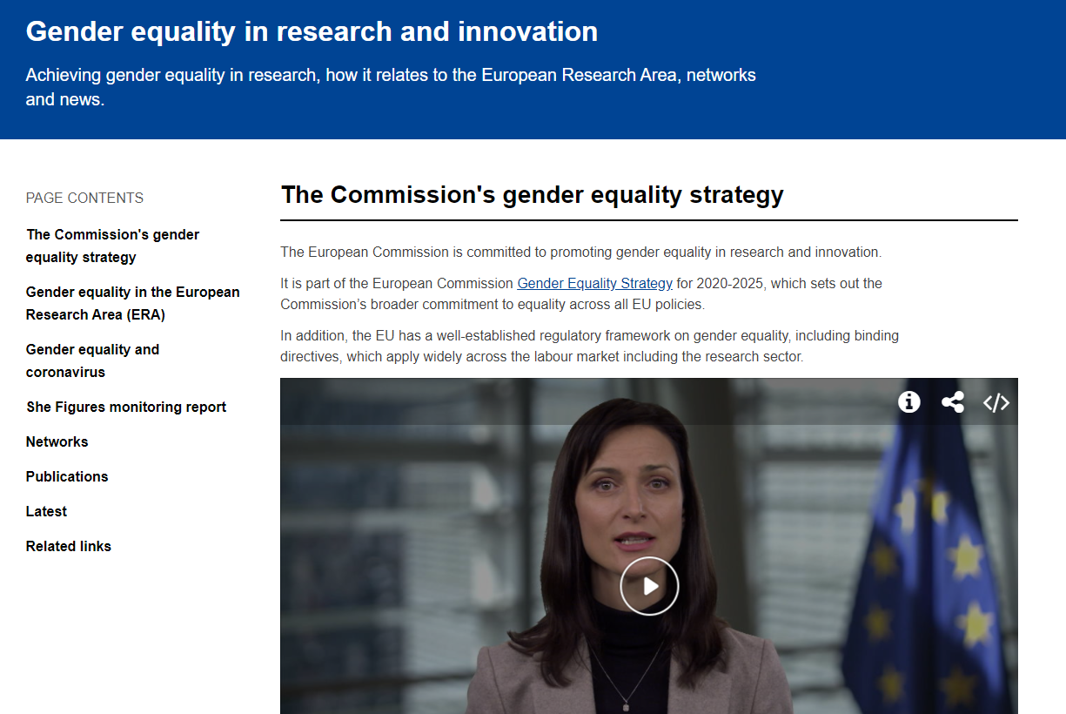
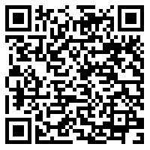
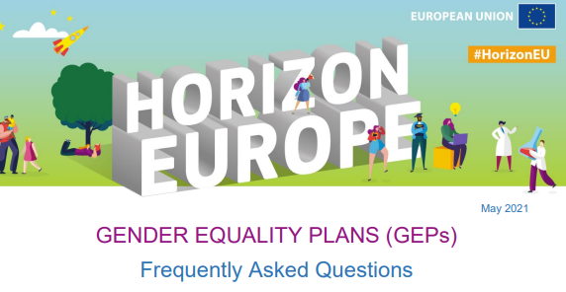
Gender Equality in R&I policy page
SCAN ME!
https://ec.europa.eu/info/research-and-innovation/strategy/gender-equality-research-and-innovation_en
https://ec.europa.eu/info/files/gender-equality-plans-frequently-asked-questions_en

Slide 27
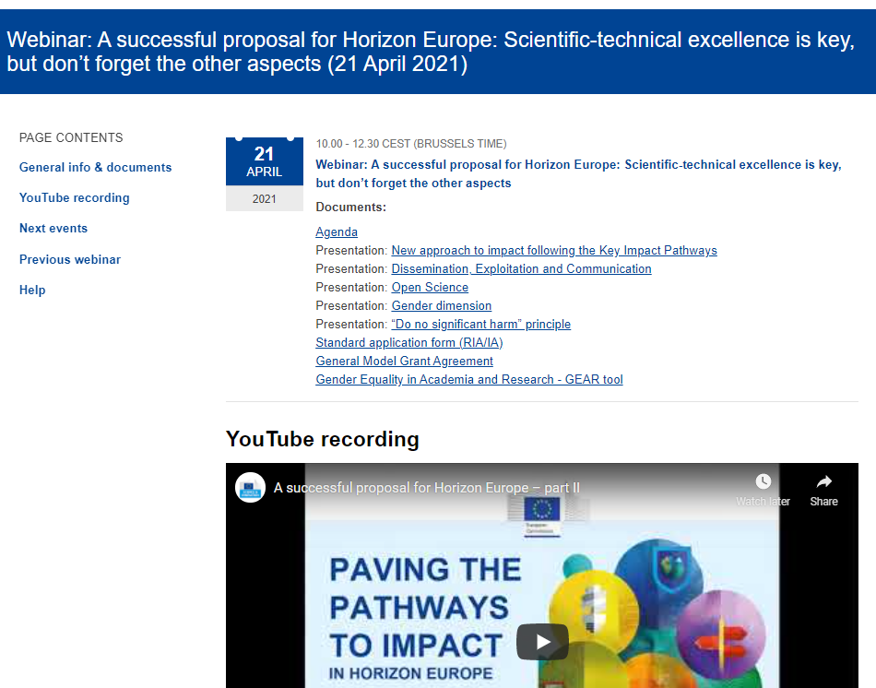
Webinar(s) on how to prepare a successful proposal for Horizon Europe
Part 1 (general + MGA): 24 March
https://ec.europa.eu/research/participants/docs/h2020-funding-guide/other/event210324.htm
Part 2 (horizontal aspects): 21 April
https://ec.europa.eu/research/participants/docs/h2020-funding-guide/other/event210421.htm

Slide 28
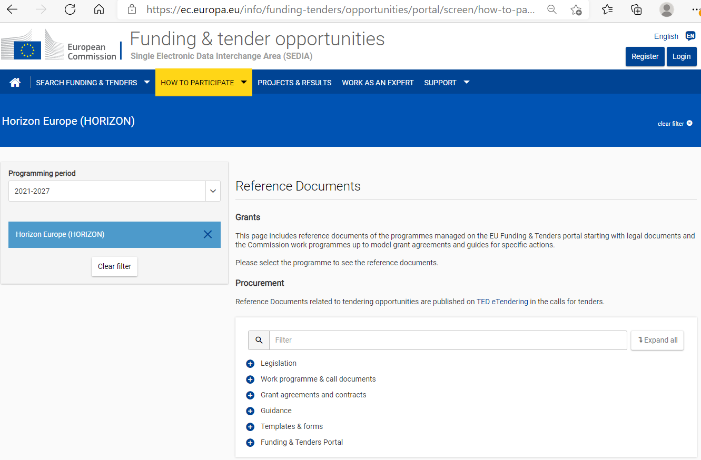
Funding & Tenders Portal
https://ec.europa.eu/info/funding-tenders/opportunities/portal/screen/how-to-participate/reference-documents

Slide 29
Thank you!
For questions specific to the GEP eligibility criterion, please contact:
RTD-HORIZON-EU-GENDER-EQUALITY-PLAN@ec.europa.eu
For other questions and further information on gender equality provisions, please contact:
RTD-GENDERINRESEARCH@ec.europa.eu
#HorizonEU
http://ec.europa.eu/horizon-europe

