Slide 1
Webinar on cross-cutting issues in Horizon Europe
SOCIAL SCIENCES AND HUMANITIES IN THE NEW EU FRAMEWORK PROGRAMME
Beatrice Lucaroni, policy officer Fair SocietiES & CULTURAL HERITAGE, DG R&I
28 May 2021

Slide 2
1. SSH disciplines for the European Commission
2. Why are SSH important?
3. How is SSH integration foreseen?
4. What to consider when preparing a proposal?
Outline

Slide 3
Social sciences and humanities
anthropology and ethnology
economics
business and marketing
human geography and demography
education
communication
history
humanities and the arts
political science, public administration
law, legal studies
psychology
sociology
project management and project-related communication activities

Slide 4
Integration of social sciences and humanities
Need for “human centric” focus across all research areas
Many R&I societal challenges are too complex to be tackled by a single or few scientific disciplines
Technical solutions alone are not sufficient to create meaningful and lasting impacts.
Need to examine in the future the societal impact of science and research, in particular for novel policies
Integration of SSH disciplines in R&I projects leads to stronger societal impact, broader citizen engagement and a better future

Slide 5
Integration of social sciences and humanities
SSH integration remains an established cross-cutting principle in HE:
→ topics will be flagged for SSH
→ monitoring of SSH integration will be followed on a yearly basis and a report produced
In HE, the integration will be more…..
→ holistic (across the entire programme and over the entire cycle)
→ explicit (expected societal impacts clearly set out)
→ forceful (explicitly evaluated and followed-up)

Slide 6
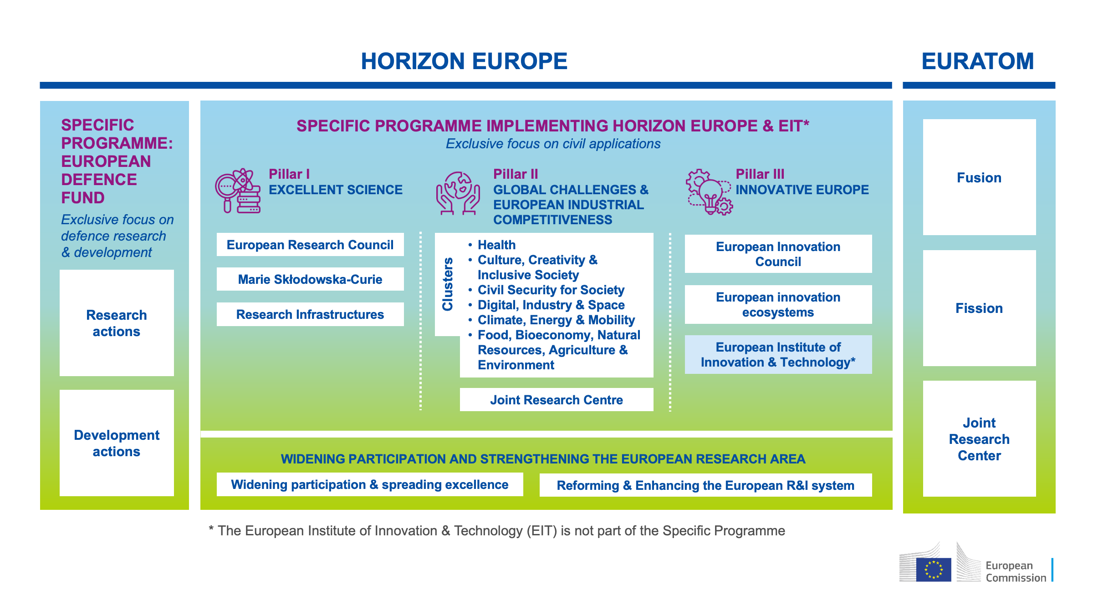
Structure of Horizon Europe
.

Slide 7
Social sciences and humanities in Horizon Europe
Cluster 2: Culture, Creativity and Inclusive Society
Dedicated to the human, social and societal aspects of EU-funded R&I
Predominantly SSH-focused
Effective integration of social sciences and humanities in all clusters
“The effective integration of social sciences and humanities (SSH) in all clusters, including all missions and partnerships, is a principle through the programme cycle. SSH are a key constituent of research and innovation, especially regarding the twin green and -digital transitions.”
(From: Horizon Europe Strategic plan)

Slide 8
Integration of social sciences and humanities – cross-cluster synergies
Synergies and complementarities of Cluster 2
Cluster 1 (health): health related socio-economic inequalities, adaptation of public health systems to societal challenges (e.g. demographics), health economics and economic models, cost-effectiveness, fiscal sustainability and accessibility of healthcare.
Cluster 3 (security): countering radicalisation and extremism, building societal resilience to disinformation and fake news, improving response to domestic violence, and protecting cultural heritage.

Slide 9
Integration of social sciences and humanities – cross-cluster synergies
Cluster 4 (digital, industry, space): qualitative research on the nature of job transformations for industry 5.0, the analysis of human-machines interactions, business models for sustainable developments, citizens’ participation and public engagement in industrial technologies, as well as cultural heritage research.
Cluster 5 (climate): engaging and enabling citizens to participate in the clean energy transition, from planning to decision-making and implementation.
Cluster 6 (food, bioeconomy, environment): improving rural well-being and long-term socio-economic prospects, promoting and valorising cultural heritage and developing innovative cultural and creative industries.

Slide 10
Some examples of SSH integration
    Social sciences (law, ethics, psychology, political sciences…) are an essential component of the research responses to public health emergencies.
    Economics and political science are major components of projects focusing on socio-economic evaluation of climate-change impact.
    Psychology, cultural considerations, ethics and religion are essential to improve the support to palliative care patients.
    Linguistics, cultural studies and ethics are an important part of projects aiming to develop AI enhanced robotic system and improve human/robot interaction.
    Economics and social sciences are essential to devise effective measures of recovery after the Covid-19 pandemic.

Slide 11
Integration of social sciences and humanities
How?
Co-creation and drafting
Topics: some are SSH flagged (some not): what does it mean?
Evaluation of the proposals
Selection of the experts
Reporting

Slide 12
HORIZON EUROPE PROPOSAL EVALUATION
How to evaluate proposals

Slide 13

Social Sciences and Humanities (SSH)
Assessing the effective contribution of social science and humanities disciplines and expertise as part of the scientific methodology of the project.
Social Sciences and Humanities
When the integration of SSH is required, applicants have to show the roles of these disciplines or provide a justification if they consider that it is not relevant for their project. A proposal without a sufficient contribution/integration of SSH research and competences will receive a lower evaluation score.

Slide 14

Standard evaluation process
Receipt of proposals
Individual evaluation
Consensus group
Panel review
Finalisation
Admissibility/eligibility check
Allocation of proposals to evaluators
Experts assess proposals individually.
Minimum of three experts per proposal (but often more than three).
All individual experts discuss together to agree on a common position, including comments and scores for each proposal.
The panel of experts reach an agreement on the scores and comments for all proposals within a call, checking consistency across the evaluations.
if necessary, resolve cases where evaluators were unable to agree.
Rank the proposals with the same score
The Commission/Agency reviews the results of the experts’ evaluation and puts together the final ranking list.

Slide 15
Evaluation (award) criteria
  Three evaluation criteria
  ‘Excellence’, ‘Impact’ and ‘Quality and efficiency of the implementation’.
  (Only one evaluation criterion for ERC - Excellence)
  Evaluation criteria are adapted to each type of action, as specified in the WP
  Each criterion includes the ‘aspects to be taken into account’. The same aspect is not included in different criteria, so it is not assessed twice.
  Open Science practices are assessed as part of the scientific methodology in the excellence criterion.

Slide 16

Evaluating the excellence criterion (2/2)
  Assess the scientific methodology:
    Is the scientific methodology (i.e. the concepts, models and assumptions that underpin the work) clear and sound? Is it in compliance with the ‘do no significant harm approach’?
    Is it clear how expertise and methods from different disciplines will be brought together and integrated in pursuit of the objectives? if applicants justify that an inter-disciplinary approach is unnecessary, is it credible?
    Has the gender dimension in research and innovation content been properly taken into account?
    Are open science practices implemented as an integral part of the proposed methodology?
    Is the research data management properly addressed?
    For topics indicating the need for the integration of social sciences and humanities, is the role of these disciplines properly addressed?

Slide 17

Evaluating the Quality of implementation (2/2)
  Assess the quality of participants and the consortium as a whole:
  (Note that important information on role of individual participants and previous experience is included in part A of proposal)
    Does the consortium match the project’s objectives, and bring together the necessary disciplinary and inter-disciplinary knowledge.
    Does the consortium include expertise in open science practices, and gender aspects of R&I, as appropriate?
    For topics flagged as SSH relevant, does the consortium include expertise in social sciences and humanities?
    Do the partners have access to critical infrastructure needed to carry out the project activities?
    Are the participants complementing one another (and cover the value chain, where appropriate)
    In what way does each of them contribute to the project? Does each of them have a valid role, and adequate resources in the project to fulfil that role (so they have sufficient operational capacity)?
    Is there industrial/commercial involvement in the project to ensure exploitation of the results?
Participants’ previous publications, in particular journal articles, are expected to be open access and existing datasets FAIR and ‘as open as possible, as closed as necessary'. Evaluate positively if this is sufficiently addressed.

Slide 18
Conclusions
Strong focus on societal impacts makes SSH real key players in HE
(Increased) Engagement of researchers and experts from SSH is necessary
Multi-disciplinarity is of paramount importance
SSH included from the onset and throughout the entire project cycle
Horizon Europe will facilitate deeper SSH integration

Slide 19


Slide 20
Information Sources
H2020 – 2018 Monitoring Report
https://op.europa.eu/en/publication-detail/-/publication/4f198f8e-4599-11eb-b59f-01aa75ed71a1/language-en/format-PDF/source-183013539
Horizon Europe: Horizon Europe | European Commission (europa.eu)
Funding information and procedures on how to apply Search Funding & Tenders (europa.eu)
Find potential project partners Find a project partner | European Commission (europa.eu)
Become an expert evaluator: https://ec.europa.eu/info/funding-tenders/opportunities/portal/screen/work-as-an-expert
Database of EU-funded projects, their results and success stories can be found on https://ec.europa.eu/info/funding-tenders/opportunities/portal/screen/opportunities/projects-results;programCode=H2020

Slide 21
Thank you!
# HorizonEU
http://ec.europa.eu/horizon-europe
21

